Slide 1
Analysis of the US Housing Market in Two US Cities from 2020-2022
Real Estate Investment Group
Nikhil Muthuvenkatesh, Seyi Oyesiku, Rohan Ukkalam, Luqing Qi

Slide 2
Project Goals
Create an efficient model able to effectively and accurately predict real estate prices in New York City and Philadelphia by making use of real estate data from the start of the pandemic in 2020 till September 2022.
We made use of real estate data from the start of the COVID-19 Pandemic up until September 2022, which we used to train and test each of our models.
We will be using several machine learning models from SKLearn to perform our predictions: Logistic Regression, Decision Tree, as well as KNN and K-Means. Then we will be testing these models with current real estate pricing to see its effectiveness.

Slide 3
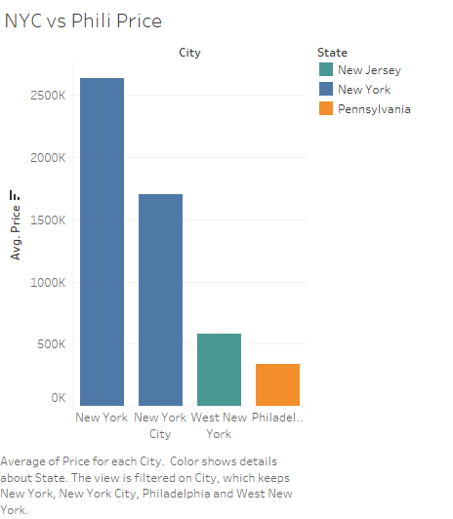
Accomplishments
Acquired and pre-processed all our data from a series of reliable sources.
Filtered the entire data down to New York and Philadelphia.
Performed exploratory data analysis of the real estate market in both cities, making use of selected key variables such as pricing, square footage, number of bathrooms, and most importantly location, all which have provided substantial insight in our analysis so far.

Slide 4
Accomplishments
We have transformed the String dates within the sold_date column into datetime objects and replaced the sold_date columns dates with a numeric representation for how many days after January 2020 the listing was sold.
We have also dropped all NaN’s in the dataset, for now, we have also applied a LabelEncoder on the city and state columns, turning them into numeric representations.
We created two tables representing the data we plan to model - one which has price as a continuous feature, and one in which price has been translated as a categorical feature representing which threshold of price the real estate listing falls under
Finally, we split and stratified the data to create a set of training and testing data to use for regression models, and a set for categorical models, then we applied a StandardScaler to the training and testing data.

Slide 5
Predictive Modeling
The models we have attempted thus far:
Multiple Linear Regression
Decision Tree Regressor
Logistic Regression
XGBoost Regression
Decision Tree Classifier
Random Forest

Slide 6
Multiple Linear Regression
This model’s accuracy score was 75.45%.
Its Mean Absolute Error was 1941391.81. Its Mean Square Error was 11027575417964.3. Its Root Mean Square Error was 3320779.33. These numbers are high, but when compared to the prices we are working with - the maximum of which is 34983250.0, it is within acceptable margins. When normalized they are 0.054, 238466.9204, and 0.0825 respectively.

Slide 7
XGBoost
The team had very limited experience with running this type of model because no one on our team had exposure to it previously.
Therefore, we had to research its implementation, and we saw a mean absolute error of 0.06205, mean square error of 421890.411, and a root mean square error of 0.1098.

Slide 8
Decision Tree Regressor
This model’s accuracy was 98.4%.
Using just one Decision Tree regressor has already proves to us that this is an excellent model to use.
We may have to evaluate the performance again with this model just to ensure that we are actually getting such a high performance and it is not a case of overfitting, but it seemed that we may not need an ensemble ML model.

Slide 9
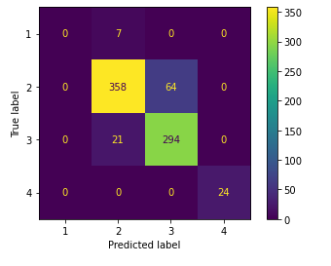
Logistic Regression
This model had an accuracy of 88.02%
We had expected that this model would perform the worst out of all of the models we used because it was the most simple one.
The confusion matrix shown here shows the strong and weak points of our LR model.

Slide 10
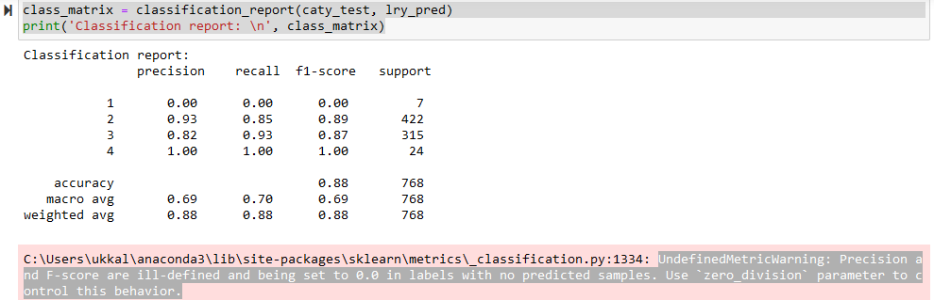
Logistic Regression

Slide 11
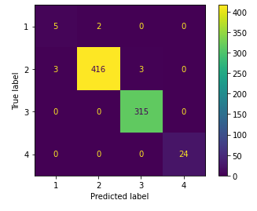
Decision Tree Classifier
This model’s accuracy score was 97.52%
It seems that the Decision Tree regressor was better suited for our data and more accurate, though we have to double check and make sure that the model is not overfitting.
The Confusion Matrix shown here tells us where the model went wrong and where it went right.

Slide 12
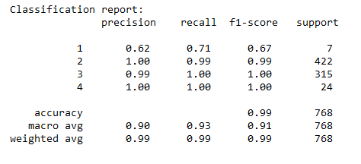
Decision Tree Classifier
This model’s accuracy score was 97.52%
It seems that the Decision Tree regressor was better suited for our data and more accurate, though we have to double check and make sure that the model is not overfitting.
The Confusion Matrix shown here tells us where the model went wrong and where it went right.

Slide 13
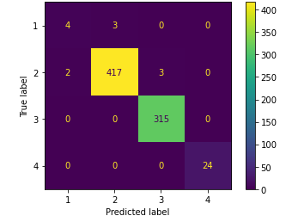
Random Forest
This model’s accuracy score was 98.04%.
This performance was slightly worse than just using one decision tree, so it seems that implementing an ensemble method actually worsened our results.
The confusion matrix shown here shows us where this model went wrong and right.

Slide 14
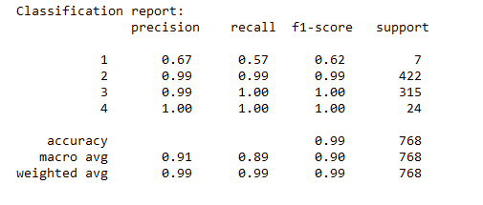
Random Forest
This model’s accuracy score was 98.04%.
This performance was slightly worse than just using one decision tree, so it seems that implementing an ensemble method actually worsened our results.
The confusion matrix shown here shows us where this model went wrong and right.

Slide 15
Public Use Database - Fannie Mae and Freddie Mac K mean Cluster Analysis
K-Mean Cluster Analysis
Elbow method to optimize the best numbers of K-mean Cluster = 4

Slide 16
Cluster 1
$5000<Average Month Income < $10000
Average Of Total Monthly Income = $6149.6
Average of Note Amount = $127487
This group has the largest number of First time buyers
This group has the largest number of USDA loans
The main reason for the loan is cash out refinance
Average Interest Rate = 2.83

Slide 17

Cluster 2
$10000 < Average Month Income < $15000
Average Of Total Monthly Income = $10338
Average of Note Amount = $259292
Average Interest Rate = 2.87
Average Borrower one age = 45
This group has the largest number of VA loans

Slide 18
Cluster 3
$15000 < Average Month Income
Average Of Total Monthly Income = $16231
Average of Note Amount = $ 446868
Average Interest Rate = 2.90
Average Credit Score = 4.48
The main reasons for the loan are purchase and no cash out refinance

Slide 19
Cluster 4
$50000 < Average Month Income
Average Of Total Monthly Income = $53704
Average of Note Amount = $404492
Average Interest Rate = 2.77
Average Borrower one age = 50
The main reasons for the loan are purchase and no cash out refinance

Slide 20
Final steps
Finish exploring all the models that we had planned to explore, and then double check the accuracy of the models selected and make sure no model is overfitting.
Take the best model and test it with novel data to see if it is truly accurate.
Once this evaluation is done, wrap up the predictor model by making it so that a user could enter information on a real estate listing and a given future year, and receive a predicted price.

Slide 21
Github Repo
All of our work including this presentation are uploaded to this github repository: https://github.com/Unlessitoldyou/DSCI-Capstone1

Slide 22
THANK YOU

